Slide 1
Buenos Aires Territorial Pricing Analysis

Slide 2
Motivation
From the point of view of the territorial investors and the people who are planning to live in Buenos Aires, they would like to live or invest in such places where the territorial prices are low and the facilities (Shops, restaurants, parks, bars…etc) and social venues are nearby.
Is it possible to create a project to help them to make decision?

Slide 3
Approach
An Excel dataset scraped from Buenos Aires government website.
Venues are requested using Foursquare API
K-Means algorithm is used for clustering the neighborhoods.
Elbow mehtod is used for select K.

Slide 4
Results

Slide 5
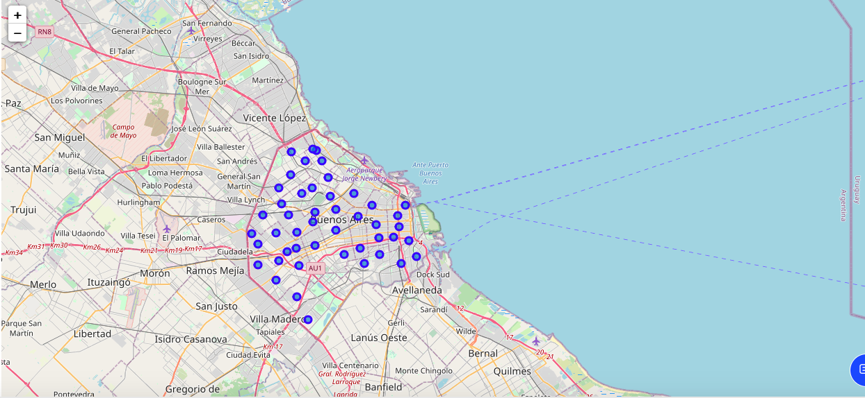
Geographical Map

Slide 6
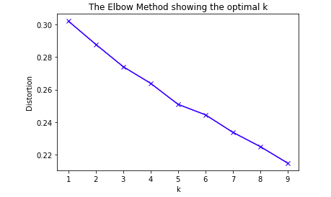
Selection of K
The best number of the cluster is 5. That is, where the elbow is located. After that, the mean squared error decrease without big changes.

Slide 7
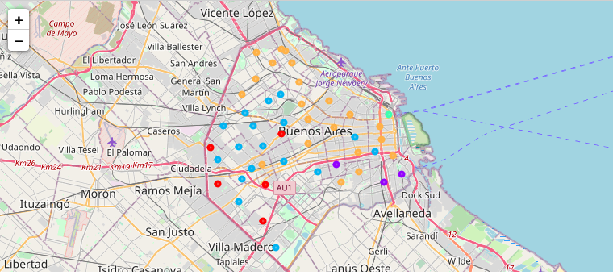
Geographical Map (Clustered)

Slide 8
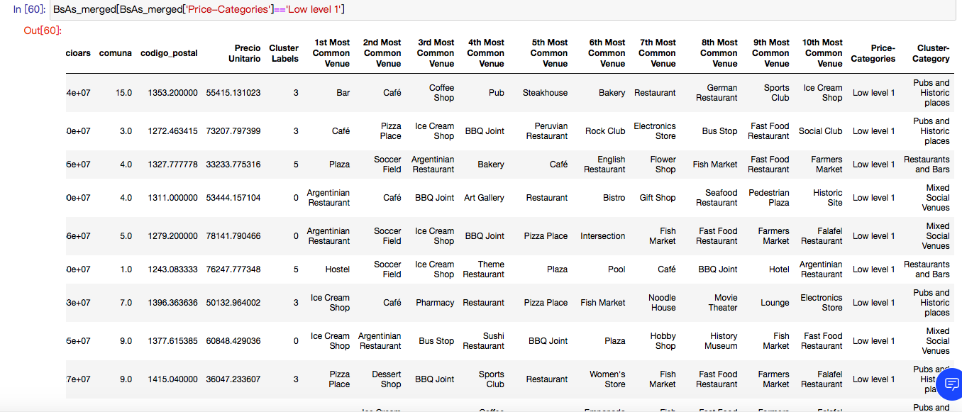
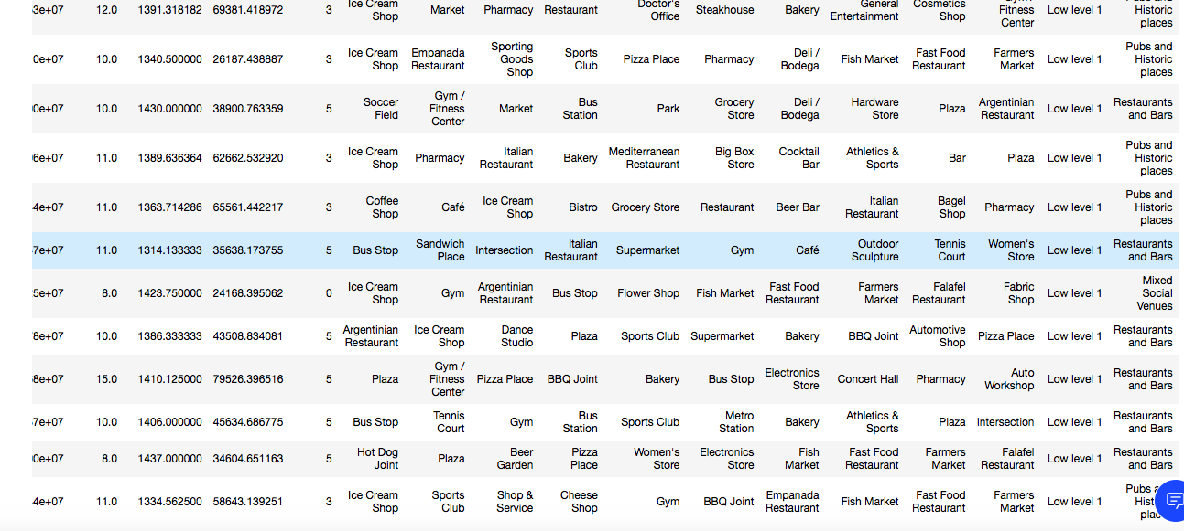
Price Category: Low Level 1

Slide 9
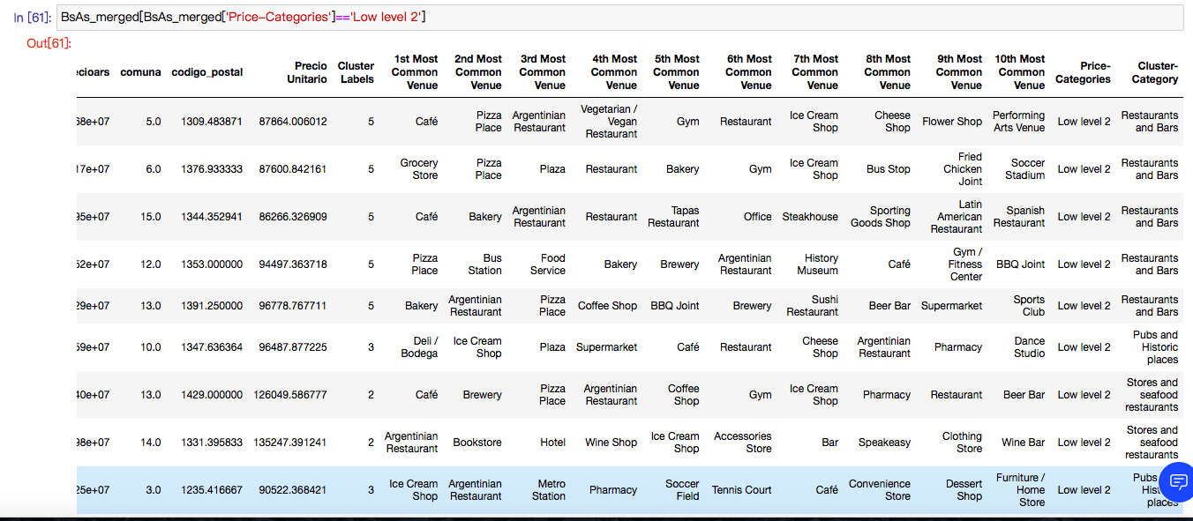
Price Category: Low Level 2

Slide 10
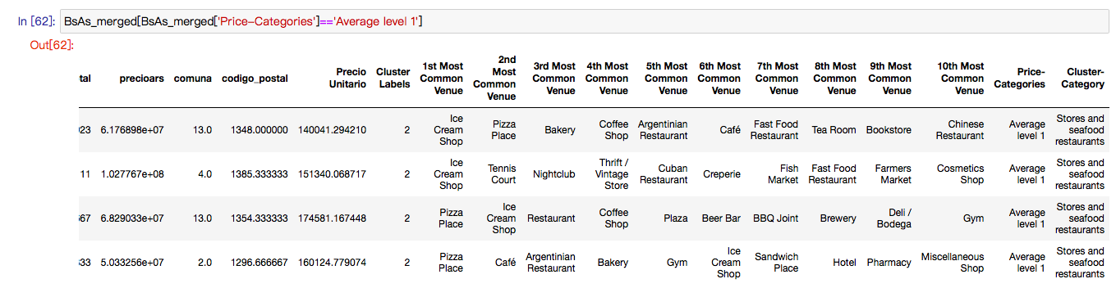
Price Category: Average Level 1

Slide 11
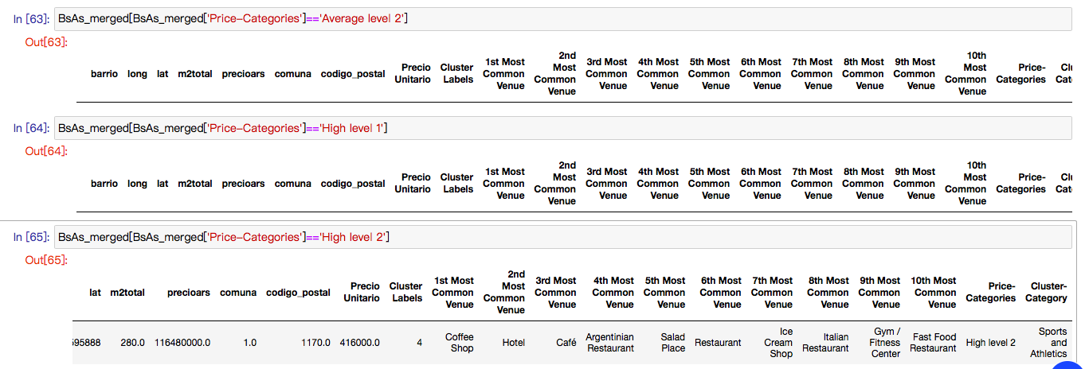
Price Category: Average Level 2, High Level 1, High Level 2

Slide 12
Conclusion
Most of the neighborhoods are classified as Low Level 1 and Low Level 2.
Almost all the low-price neighborhoods are close to restaurants, bars, pubs, etc. The boroughs with higher territorial price are mostly nearby stores, seafood restaurants, and also sport facilities.

